Slide 1

Containerized Notes Application
Cloud—Native Deployment with Docker, Kubernetes & AWS
Himanshu Fulera
Reg No: 12304291
In partial fulfilment for the requirements of the award of the degree of
Bachelor of Technology( Computer Science)

Slide 2
Brief description of the project idea:
A robust, cloud—hosted web application engineered to demonstrate modern DevOps practices, container orchestration, and seamless cloud infrastructure management.
Live Application Demo: http://16.170.204.49:30007/ EC2 instance.) (Note: Availability is contingent on the active state of the underlying AWS
Core Features
CRUD Operations: Complete capability to Add, View, and Delete notes.
Responsive UI: Frontend designed with HTML, CSS, and JS to adapt to various screen sizes.
Immutable Infrastructure: Containerized environment ensuring code runs consistently.
Self-Healing Orchestration: Kubernetes deployment ensuring pod restarts in the event of failure.

Slide 3
Technology Used:
Technology Role Technical Justification
Python Flask
Backend Lightweight & WSGl-compliant
microframework.
Container Standardized environment for
consistent runtime.
Docker
Kubernetes
Orchestration
Automated scaling, networking, and
self—healing.
AWSEC2
Cloud IaaS
Scalable compute resources for
hosting Minikube.

Slide 4
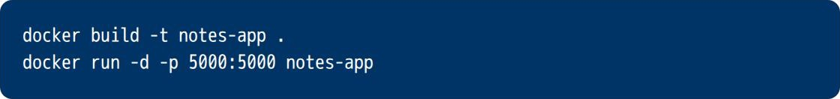
Phase 1: Dockerization & Hub
1. Build & Tést
Packaging the Python environment and app logic into an immutable image.
2. Global Registry
Pushing the tagged image to Docker Hub for remote cloud access.

Slide 5
Phase 2: Cloud & K8s Deployment
AWS Provisioning
Deployment of m7i-flex.large Ubuntu instance in eu—north—1. Security groups configured for SSH and NodePort traffic.
Minikube Setup
Initializing a single—node Kubernetes cluster within the EC2 environment using the Docker driver.
Service Manifests
Exposing the application internally and externally via service. yaml NodePort.
Deployment Manifests
Defining Pod replicas and container images via deployment.yaml.

Slide 6
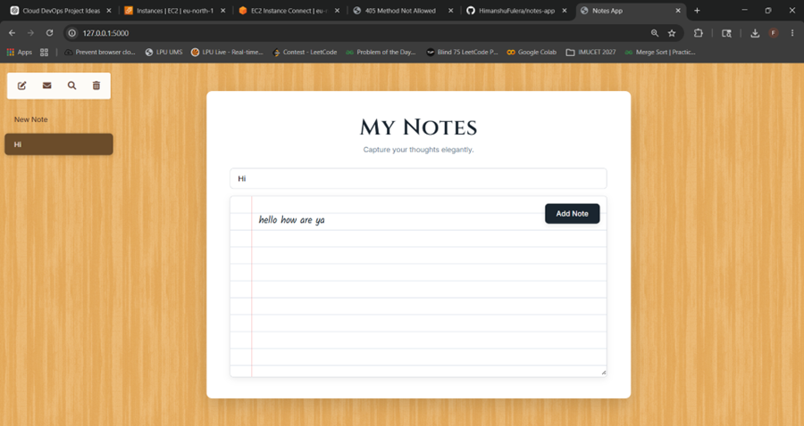
Screenshots / Output Results:
Application User Interface (Homepage)

Slide 7
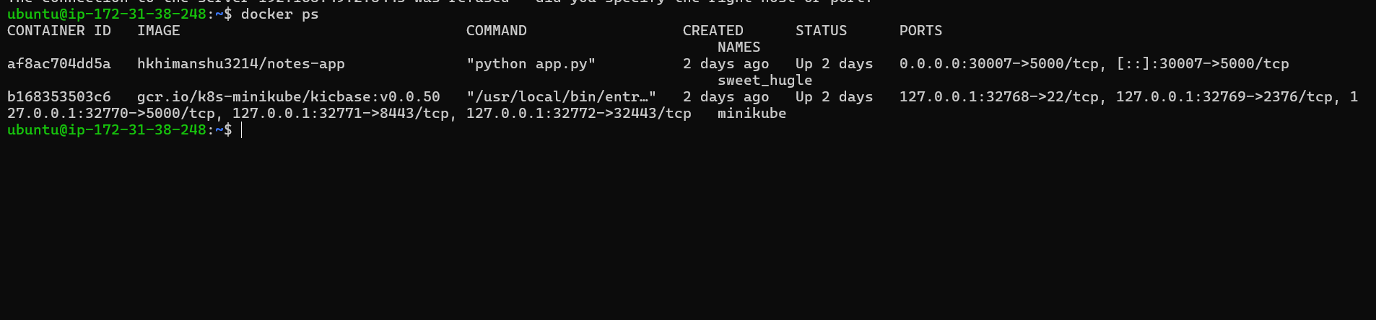
Container Runtime Environnent (Docker PS)

Slide 8
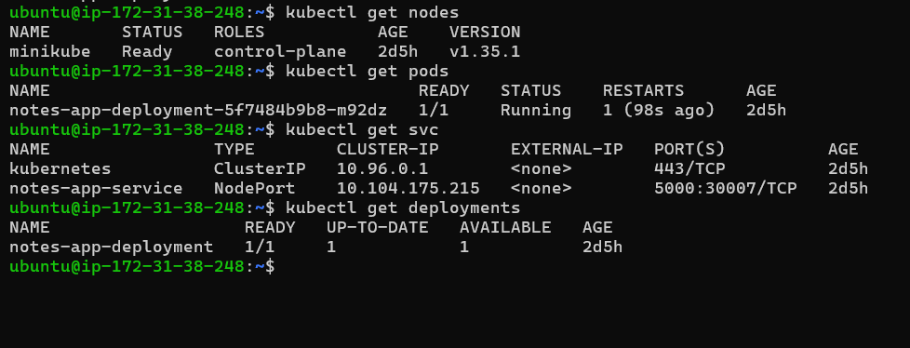
Kubernetes Pods & Services

Slide 9
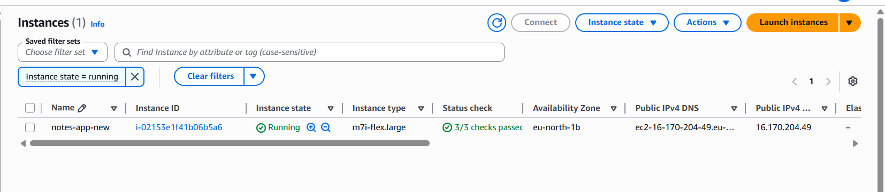
AWS EC2 Dashboard

Slide 10
GitHub Link:
https://github.com/HimanshuFulera/notes-app
Hosted Website Link:
http://16.170.204.49:30007/

Slide 11
Future Scope:
CI/CD Integration: Implement a Jenkins pipeline for automated deployment.
Persistent Storage: Integrate AWS RDS or Kubernetes Persistent Volumes to prevent data loss.
Domain Mapping & SSL: Map EC2 IPv4 to a custom domain using AWS Route53 and secure endpoints with HTTPS.
Conclusion
The Containerized Notes Application successfully bridges the gap between software development and IT operations. By integrating Docker for consistent artifact generation and Kubernetes for resilient deployment, the project guarantees zero-downtime potential and high scalability. Deploying the cluster on AWS EC2 provided hands-on exposure to cloud provisioning, network security groups, and public internet routing.

